Slide 1
House Price Modelling: Ames
By: Dylan Teo

Slide 2
OBJECTIVE
Developing an accurate model to predict the sales price of a house

Slide 3
SCORING
Minimising the Root Mean Squared Error (RMSE)

Slide 4
DATA: House Prices for Ames, Iowa
Source: Ames Assessors’ Office
Number of records: 2,930
Categories of variables: 81
Target category: Sales Price
Other categories :
Year Sold
First Floor Area
No. of Bathrooms
Utilities
Garage Area
etc.

Slide 5
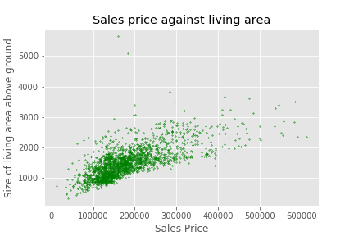
Exploratory Data Analysis (EDA)
Check for outliers.
2 sales that were under priced (mentioned in the CV)
Removing of the ID and PID columns, as these are just ID numbers.

Slide 6
Exploratory Data Analysis (EDA)
Classifying the 79 remaining variables and to create filters for;
Continuous (19)
Discrete (12)
Nominal (24)
Ordinal (23)
Identify the null values and check;
if information is actually missing
It is the lowest score/category (eg. if a house does not have a feature)

Slide 7


Data cleaning:
Dealing with Ordinals
Most are graded features (eg quality of the house), which are non-numerical.
To remedy, all the scores are converted to an equivalent numerical grade.
Some of the lowest grades are “NA”, which results in null values.
Identifying these lowest “NA” grades and replacing it with the lowest numerical grade

Slide 8
Data cleaning:
Dealing with Discrete and Nominals
Identify the null values and assess;
Whether the null value is there as an indication of an absence of a feature
If the data is missing, deductions will be made from similar variables in order to estimate the missing data.
Once identified, the null values will be replaced by a zero or ‘NA’.
Dummy Variables will be created for all remaining columns.

Slide 9
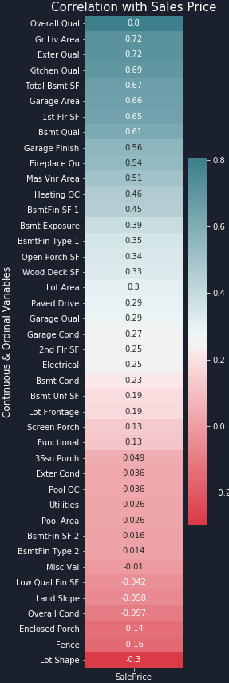
Feature Selection:
Correlation
Correlation for the Sales Price and the Continuous and Ordinal variables are tested.
Those that exhibit a stronger correlation are selected for modelling.

Slide 10
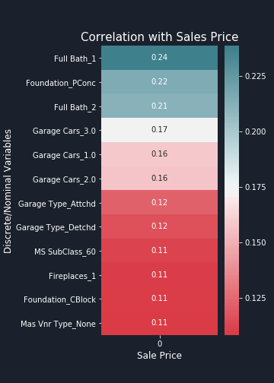
Feature Selection:
Mutual Information
Mutual information is tested for the Discrete and Nominal Variables to identify those with strong dependency with the Sales Price.
Those with higher scores are selected for the modelling.

Slide 11
Selection Criteria
Correlation > 0.3
Correlation < -0.2
Mutual Information score > 0.15

Slide 12
25
Selected variables

Slide 13
Preparation for modelling
The data of the 25 variables will be scaled using the StandardScaler before sending it to the model.
The test dataset will be imported now in order to run the model and predict the prices for the houses in the test dataset.
The data will be cleaned and scaled in the same manner as discussed in the previous few slides.

Slide 14
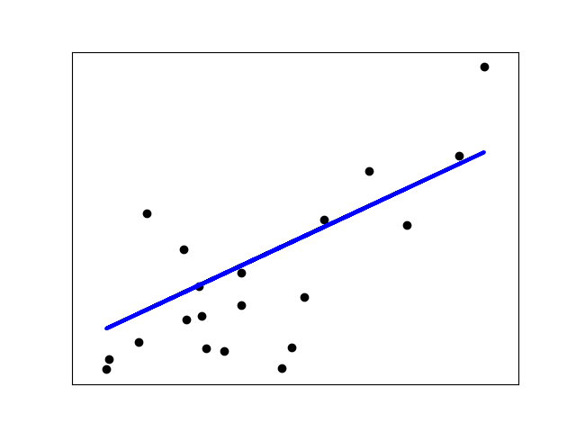
Modelling:
Linear Regression
Basic Linear Regression modelling for the 25 variables, which will be the BASELINE SCORE.
TRAINED RESULTS
AVERAGE R-SQUARED: 88.58%
AVERAGE RMSE: 26,687
KAGGLE SCORE
PUBLIC RMSE: 28,550
PRIVATE RMSE: 32,767

Slide 15

Modelling:
Ridge
Ridge Regression modelling for the 25 variables.
TRAINED RESULTS
AVERAGE R-SQUARED: 88.6%
AVERAGE RMSE: 26,660
KAGGLE SCORE
PUBLIC RMSE: 28,954
PRIVATE RMSE: 32,667

Slide 16
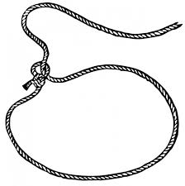
Modelling:
Lasso
Lasso Regression modelling for the 25 variables.
TRAINED RESULTS
AVERAGE R-SQUARED: 88.58%
AVERAGE RMSE: 26,684
KAGGLE SCORE
PUBLIC RMSE: 28,626
PRIVATE RMSE: 32,715

Slide 17
Findings
There is no clear optimal model as the difference between the three are minimal
Neither Ridge nor Lasso removed or nullified any of the variables

Slide 18

Conclusions:
Selection of variables during the feature selections (using correlation and mutual information) reduced the chances of overfitting and the impact of the Ridge and Lasso regressions.

Slide 19
Feature Selection is the most important factor in accurate modelling.

Slide 20
“There are two kinds of statistics,
the kind you look up and the kind you make up.”
- Rex Stout

